Slide 1
Grab & Go Flu & COVID Professional Development Support

Slide 2
Hold Here for Facilitator Information
This is a placeholder slide for the facilitators name, job title, etc.
Notes:
Include your facilitator’s name, photo and bio.

Slide 3
Session Goals
Discuss the difference between the flu and COVID-19
Explain the importance of obtaining a flu vaccine
Investigate national and local resources pertaining to flu and COVID-19
Identify ways that child care programs and community partners can assist families and children with staying healthy

Slide 4
Hold for quote/Opening discussion picture

Slide 5
Flu vs. COVID-19

Slide 6
The Symptoms: Flu vs. COVID-19
AAP, 2020
Notes:
This is part of a resource created by Child Care Aware of America to showcase the differences between the two virusesReview the slide with participants and have a short discussion.

Slide 7
How They Spread: Flu vs. COVID-19
Similarities
Differences
Spread person to person
Can spread before symptoms develop
COVID-19 is more contagious among certain populations
More superspreading events
CDC, 2020
Notes:
https://www.cdc.gov/flu/symptoms/flu-vs-covid19.htm
Similarities:
Both COVID-19 and flu can spread from person-to-person, between people who are in close contact with one another (within about 6 feet). Both are spread mainly by droplets made when people with the illness (COVID-19 or flu) cough, sneeze, or talk. These droplets can land in the mouths or noses of people who are nearby or possibly be inhaled into the lungs.
It may be possible that a person can get infected by physical human contact (e.g. shaking hands) or by touching a surface or object that has virus on it and then touching his or her own mouth, nose, or possibly their eyes.
Both flu virus and the virus that causes COVID-19 may be spread to others by people before they begin showing symptoms, with very mild symptoms or who never developed symptoms (asymptomatic).
Differences:
While COVID-19 and flu viruses are thought to spread in similar ways, COVID-19 is more contagious among certain populations and age groups than flu. Also, COVID-19 has been observed to have more superspreading events than flu. This means the virus that causes COVID-19 can quickly and easily spread to a lot of people and result in continuous spreading among people as time progresses.

Slide 8
High Risk for Severe Illness: Flu vs. COVID-19
Similarities
Differences
Same high-risk populations:
Older adults
People with certain underlying medical conditions
Pregnant people
Young children are at higher risk of severe illness from flu
School-aged children infected with COVID-19 are at higher risk of Multisystem Inflammatory Syndrome
CDC, 2020
Notes:
https://www.cdc.gov/flu/symptoms/flu-vs-covid19.htm
Similarities:
Both COVID-19 and flu illness can result in severe illness and complications. Those at highest risk include:
Older adults
People with certain underlying medical conditions
Pregnant people
Differences:
The risk of complications for healthy children is higher for flu compared to COVID-19. However, infants and children with underlying medical conditions are at increased risk for both flu and COVID-19.
Flu
Young children are at higher risk of severe illness from flu.
People at High Risk for Flu Complications
COVID-19
School-aged children infected with COVID-19 are at higher risk of Multisystem Inflammatory Syndrome in Children (MIS-C), a rare but severe complication of COVID-19.
People at Increased Risk of COVID-19 Severe Illness

Slide 9
The Flu Vaccine
The Why, Who, When and Special Considerations for How
Notes:
Now let us take a look at the flu vaccine overall. We will discuss why people need one, who needs one and a few special considerations for this particular flu season that is taking place during a pandemic.

Slide 10
Children and Child Care
Children and child care providers are at increased risk for contracting flu due to their group setting.
Children under five are at higher risk of developing flu-related complications
CCAoA, 2020
Notes:
Discuss key points from the Child Care Aware of America Flu brief resource.

Slide 11
Who Should Get a Flu Vaccine & When
CDC recommends that people get a flu vaccine by the end of October.
However, getting vaccinated early (for example, in July or August) is likely to be associated with reduced protection against flu infection later in the flu season, particularly among older adults.
(CDC, 2020)
Notes:
https://www.cdc.gov/flu/prevent/vaccinations.htm
https://www.cdc.gov/flu/prevent/vaccinations.htm#when
When should I get vaccinated?
You should get a flu vaccine before flu viruses begin spreading in your community, since it takes about two weeks after vaccination for antibodies to develop in the body and provide protection against flu. Make plans to get vaccinated early in fall, before flu season begins. CDC recommends that people get a flu vaccine by the end of October. However, getting vaccinated early (for example, in July or August) is likely to be associated with reduced protection against flu infection later in the flu season, particularly among older adults. Vaccination should continue to be offered throughout the flu season, even into January or later. Children who need two doses of vaccine to be protected should start the vaccination process sooner, because the two doses must be given at least four weeks apart.

Slide 12
Special Considerations During COVID-19
Many children are behind in their regular pediatrician visits
Limited appointment availability
Less preventative health care services/access
Accessing flu vaccines may be an opportunity to catch up on other vaccines
CCAoA, 2020
Notes:
The 2020-21 flu season is occurring amid the COVID-19 pandemic. While several COVID-19 vaccines are in trial, widespread availability likely will not occur until well into or after this flu season (ref). Many individuals may be weary of accessing health care due to fears of contracting COVID-19 in health care settings. In fact, many children have fallen behind on other routine vaccines due to reductions in pediatric health care service visits. Fewer families are going to see their pediatrician due to provider closure, limited appointment availability and/or fear of accessing services during the pandemic. This season presents an opportunity for children to get caught up on key preventive health care services such as vaccines and other screenings when they visit their pediatrician for a flu shot.

Slide 13
Additional Prevention Measures
What You Can Do in Addition to Getting Your Flu Shot

Slide 14
Cleaning & Sanitation
Understanding the difference between cleaning and sanitation
Using the proper solutions for the cleaning different surfaces and or materials
Resource:
Blog Post: Cleaning and Disinfection in Child Care Programs
CCAoA, 2020
Notes:
The Blog Cleaning and Disinfection in Child Care Programs is a great resource to leverage as you navigate trough keeping your program healthy. First, it’s important to understand the difference between cleaning, sanitizing and disinfecting. In short, cleaning means removing dirt or germs from a surface; sanitizing refers to reducing the number of pathogens or bacteria on that cleaned surface; disinfecting kills all bacteria on hard, non-porous surfaces. The distinction between the three can seem blurry, so we have gathered some of the most helpful links from partners in public health to ensure you are ready and prepared.

Slide 15
Child Care Program Support
Increasing the frequency of handwashing and hand sanitizing during flu season might help reduce infection
Children and adults should ideally cough into an elbow or shoulder so that the germs do not end up on the hands.
Resource:
Why Child Care Staff Need to Care About Flu Prevention
CCAoA, 2020
Notes:
Share the resource in the hyperlinked titles on the slide and briefly discuss them and how they can be used to decrease the spread. The bulleted items are just some quick tip highlights from the blog. Invite the participants to review the blog in its entirety.

Slide 16
Supporting Children and Families
Teaching Children About the Flu
Includes lesson plans and activities for young children
Coloring pages and songs to encourage healthy practices
Prepare-Your-Family-for-Flu-Season
Information about flu shot options
Tips on keeping their family safe at home
CDC, 2020 & AAP, 2020
Notes:
Share the resources in the hyperlinked titles on the slide and briefly discuss them and how they can be used to decrease the spread. These bulleted points are just quick highlights. Encourage the participants to share these resources in full with the families in their program.

Slide 17
National & Local Resources
For Programs, Families and General Needs
Notes:
Now we are going to look at the national resources out there to support your work in keeping yourself and those in your program safe and healthy.

Slide 18
Center for Disease Control
Information and resources to inform your work and support the families in your program such as:
Social media toolkit
Multilanguage fact sheets
Print materials to share with families and community partners
Free videos
#SleeveUp webpage
CDC, 2020
Notes:
Tell the participants that you will be going over some of the resources the CDC has to offer over the next few slides.
Depending upon the facilitators comfort level, you may want to go to the actual CDC website and do a short tour of how to navigate through the tools and resources.
Please encourage your families and community partners roll their sleeves up for an annual flu vaccine by featuring photos of your organization’s leader and/or community members with their #SleeveUp getting their flu vaccine or showing off their bandage from having gotten a flu vaccine. Use the social media “frames” and other graphics to help promote flu vaccination to reduce flu illnesses, hospitalizations, and deaths this fall and winter and save medical resources for the care of COVID-19 patients. These resources can also be found on the #SleeveUp webpage.

Slide 19
Roll your Sleeve Up to Fight Flu
This CDC campaign is geared at encouraging people to get their flu shot and continue to mask up and wash their hands.
It also includes a social media toolkit
CDC, 2020
Notes:
https://www.cdc.gov/flu/resource-center/sleeveup/index.htm
https://www.cdc.gov/flu/resource-center/toolkit/index.htm

Slide 20
Multi Language Fact Sheets
Printable and sharable
Can be used to post in your program
Covers many topic areas
CDC, 2020
Notes:
https://www.cdc.gov/flu/resource-center/freeresources/multi-language-factsheets.html
Share that this is photo on the slide is just one sample of the many fact sheets they have to pick from on the website. If this is an in person session, you may want to print out a sample page or two. Or if it is virtual you can add a few sample pages to the handouts for the session.

Slide 21
Print Materials
Free resources you can print and or order copies
In English and Spanish
CDC, 2020
Notes:
https://www.cdc.gov/flu/pdf/freeresources/general/strong-defense-against-flu.pdf
https://www.cdc.gov/flu/pdf/freeresources/spanish/preventing_and_treating_fluenza_sp.pdf.pdf
Share that this is photo on the slide is just one sample of the many fact sheets they have to pick from on the website. If this is an in person session, you may want to print out a sample page or two. Or if it is virtual you can add a few sample pages to the handouts for the session.

Slide 22
Videos
Videos to share via social media, your website, emails to parents and much more
CDC, 2020
Notes:
https://www.cdc.gov/flu/resource-center/freeresources/video/media-psa.htm Click on the black box to make the play button come up.
Encourage the group to go to the website themselves after the training so the can see all of the video options or take time to show them during the session if you feel comfortable.

Slide 23
The American Academy of Pediatrics
Children should receive the flu vaccine as soon as it is available in their community and complete their vaccinations ideally by the end of October
Children 6 months to 8 years of age should receive two doses if this is the first time they are being vaccinated against influenza, or if they have only received one dose of flu vaccine ever before July 1st, 2020
AAP, 2020
Notes:
https://services.aap.org/en/news-room/news-releases/aap/2020/american-academy-of-pediatrics-issues-2020-21-recommendations-on-preventing-influenza/
https://pediatrics.aappublications.org/content/pediatrics/early/2020/09/14/peds.2020-024588.full.pdf

Slide 24
Recommendations for Prevention and Control of Influenza in Children
“Children play a pivotal role in the transmission of influenza to others in their household. They can also get seriously ill from influenza without a vaccination.”
Flor Munoz, MD, FAAP, lead author of the AAP Committee on Infectious Diseases recommendations

Slide 25
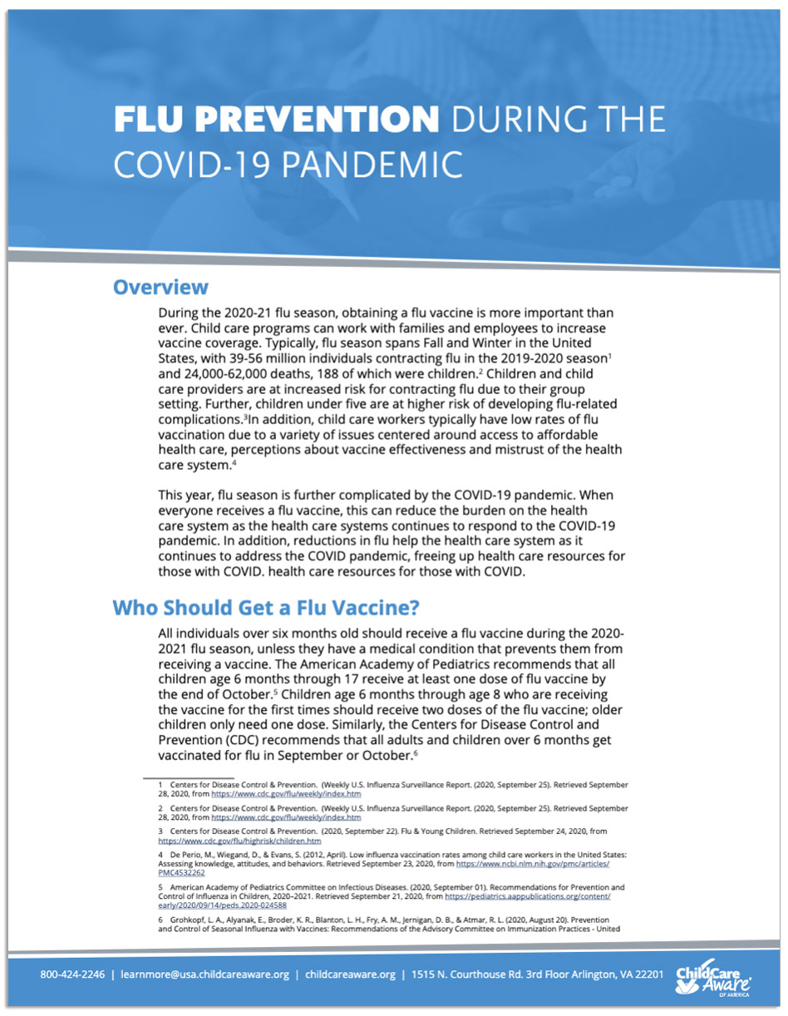
Child Care Aware® of America
Flu Prevention During the COVID-19 Pandemic
Includes general information about the flu and guidelines for child care providers to follow.
CCAoA, 2020
Notes:
Please have a copy of the current resource on the slide to share with the participants. At this time give the participants 2 minutes to review the document and then have a 5 minute or less discussion about their take away from their review of the resource.

Slide 26
Child Care Aware™ of America
COVID-19, Flu & You:
Includes the comparison chart used earlier and other helpful information pertaining to COVID-19 and the Flu
Infectious Disease in Child Care:
E-book to help with the development of policies and plans to reduce the spread of illness in a child care program
Additional Resources
Find all these resources and more at childcareaware.org/flu
CCAoA, 2020
Notes:
Brief: https://www.childcareaware.org/wp-content/uploads/2020/10/FluSeason-IssueBrief-10022020.pdf
E-book: https://info.childcareaware.org/ty-infectious-disease-in-child-care-e-book

Slide 27
Hold for Local Resources & Regulations
This is a place holder for CCR&Rs to share, update, remind programs about any local and or state resources and regulations that child care providers need to leverage.

Slide 28
Reflections
Are there any resources that were just shared that you plan to use for your program?
How would you utilize the resources to support your work?

Slide 29
Business Considerations for the Flu

Slide 30
Peer-to-Peer Connections
Business Considerations:
Staff paid sick time
Child illness and returning to the program
Paid time off for health checks/screenings/flu shoots for staff
Budgeted expenses for extra sanitation needs
Notes:
Have the participants share with their elbow buddy and have a quick discussion. Then share out with the group. In small group settings you can just have them share out as a group.
If the group is having trouble with the question give them the examples of policies and procedures around coming into work ill, time off allowances for check ups/ health screening, flu shots, etc. The goal of this slide is to help the child care programs with understanding the business side of the work and ensure that they have set themselves, their staff and their business up for success.

Slide 31
Business Practice Support for the Flu
Helping you and your staff understand the signs to look for and when to stay home to keep others safe from illness
Notes:
https://www.cdc.gov/flu/pdf/freeresources/updated/stay-home-from-work-poster.pdf

Slide 32
Supporting a Community Vaccination Clinic
Collaborate with your local CCR&R and local health department to provide off site/temporary vaccination clinics
Provides a quick one stop place for employees to get their vaccine and return to work.
CDC, 2020
Notes:
https://www.cdc.gov/flu/business/hosting-vaccination-clinic.htm
https://www.izsummitpartners.org/naiis-workgroups/influenza-workgroup/off-site-clinic-resources/
https://www.izsummitpartners.org/content/uploads/2019/02/off-site-vaccination-clinic-checklist.pdf
https://www.izsummitpartners.org/content/uploads/2019/02/faqs-for-checklist-and-pledge.pdf

Slide 33
Wrap Up & Questions
Notes:
Take this time to check in with the group and review the session goals to ensure they were obtained. You can also use this time to have a short Q&A session with the participants.
Here is a Flu FAQ from the CDC that might be helpful: https://www.cdc.gov/flu/season/faq-flu-season-2020-2021.htm
You may want to have a state or local FAQ resource available at this time. Many times when questions seem to be to program specific and it may effect the programs licensing status, don’t be afraid to encourage the program to reach out to their licensing consultant as well.

Slide 34
Referenced Resource Websites & Abbreviations
Child Care Aware™ of America (CCAoA)
https://www.childcareaware.org
American Academy of Pediatrics (AAP)
https://www.aap.org/
Center for Disease Control & Prevention (CDC)
https://www.cdc.gov/

Slide 35
Hold for Agency/Facilitator Information
This is a placeholder for the facilitator to remind programs of their services, upcoming trainings, the agency logo,etc.
Notes:
Use this slide to share with the participants the great resources and trainings that your agency has to offer. This is a great time to shine and build your brand and make connections for future TA offerings.

